Slide 1
Environmental DNA
Lesson plan

Slide 2
Learning outcomes
After today’s lesson I hope we will be able to answer these questions:
What is DNA?
When does DNA become environmental DNA (eDNA)?
How do you use eDNA?
How can eDNA help conserve and protect our endangered species?

Slide 3
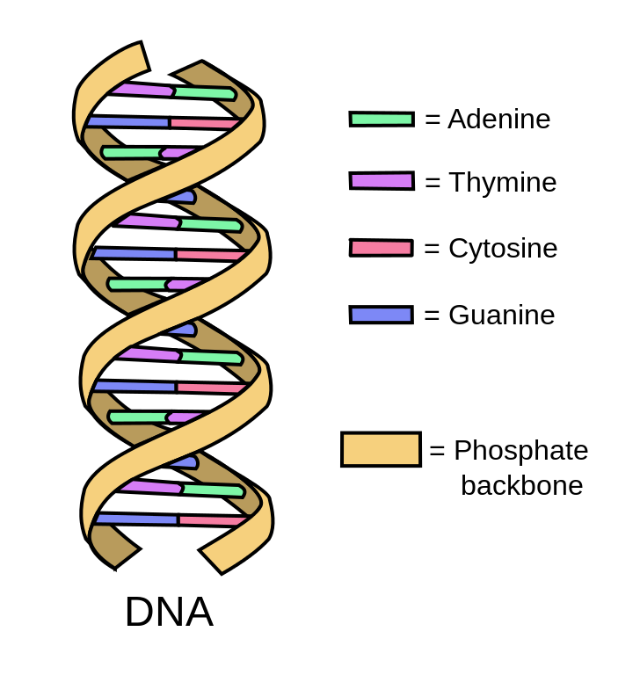
Crash course in DNA
Introduction:
DNA stands for DeoxyriboNucleic Acid.
DNA is the blueprint of almost all living things (it carries instructions for growth, development, and reproduction).
DNA structure:
DNA structure is formed up of two chains wound into a twisted, helical structure, almost like a microscopic spiral staircase.
The building blocks of DNA are called nucleotides.
These little structures are made up three parts: a molecule of sugar and one of phosphoric acid (this forms the phosphate backbone) and a chemical base, which is one of four: Adenine, Thymine, Guanine, Cytosine.
Adenine can only bind to Thymine, and Guanine can only bind to Cytosine (base pairing rules).
The nucleotides are bound together in a long chain by covalent bonds. Two single DNA strands come together using hydrogen bonding (according to base pairing rules); this forms the double-stranded DNA!

Slide 4
Prepare to be amazed
How similar is our DNA to…?
96
Chimpanzees | %
Rats | %
Bananas | %
Other humans | %
90
60
99.9
Fun facts If all the DNA within your body was unravelled, it would reach to the sun and back roughly 70 times.
Almost 99% of our DNA has a largely unknown function and is called noncoding DNA.
Notes:
Humans share 96% of DNA with chimps, 90% with mice, 60% with bananas, 99.9% with each other

Slide 5
Dna in the classroom
If this is what one strand of DNA is like, predict what the complimentary second strand would be…
AGTGTAAC
TTGACCGTAA
TCTCTGGGATCTAGTT
TCACATTG
AACTGGCATT
AGAGACCCTAGATCAA

Slide 6
DNA & eDNA
Certain sections of a species’ DNA are unique to that species, i.e. the sequence of bases (A,T,G and C) are specific to one particular species.
This means that we can use these unique sections of a DNA sequence as ‘barcodes’, similar to how a barcode in a supermarket is used to identify an item.
This is the premise of how we use environmental DNA to detect species from an environmental sample.
AGCTTTACGGTA
TCGAAATGCCAT
Can be used as a ‘barcode’ to identify what species the DNA came from
Unique section of DNA

Slide 7
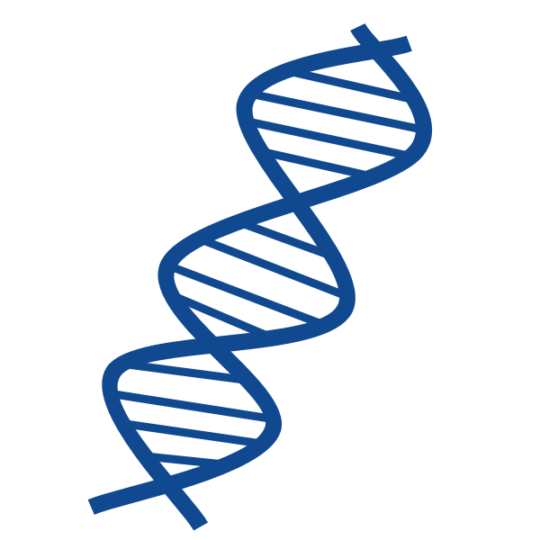
What is Environmental DNA?
eDNA is genetic material taken from an environmental sample rather than directly from an organism.
When organisms move within their environment they shed fragments of DNA such as hair, saliva, faeces, bones, scales, or skin cells (all of these are made up of DNA!).
Environmental samples that can contain eDNA are water, soil, sediment, snow, ice and even air.
Once DNA is left in the environment, its preservation varies from weeks in warm, tropical water to hundreds of thousands of years in cold, dry permafrost.
Waste
Free DNA
Damaged tissue
Skin/hair/scales
Sources of eDNA in water
Fun fact
DNA of a woolly mammoth has been found from permafrost samples!
Notes:
.

Slide 8
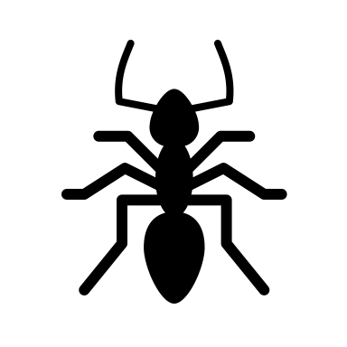
How do you use eDNA?
We use the ‘barcode’ sections to identify which species the collected eDNA is from.
The steps:
Collect the sample from the environment: sediment/water/snow/soil.
Extract the eDNA: the environmental sample is placed into a tube and all of the eDNA is extracted.
Amplification using Polymerase Chain Reaction (PCR): this is a process of making millions of copies of the target ‘barcode’ section.
Sequencing: a sequencing machine will read the strands and identify what order the bases are.
Bioinformatics: sequence DNA ‘barcodes’ are then compared to known sequences and matched up to a species.
Celebrate!
1.
2.
3.
4.
5.
6.
Notes:
PCR – do this as it will make it easier to identify the species if there are lots and lots of copies of the ‘barcode
Collect the environmental sample
Extract the eDNA from the environmental sample
PCR = polymerase chain reaction; this is a process of making millions of copies of the ‘barcode’ sections
Sequencing machine will read the strands and identify what the order of bases are
These sequenced DNA ‘barcodes’ are then compared to known sequences and matched up to a species

Slide 9
Why is eDNA useful?
eDNA
Reduced cost
Reduced time
More accurate
Non-invasive/no disturbance
Identify species that look similar
Identify species that are hidden
Traditionally, scientists have monitored ecosystems by physically exploring habitats, identifying which species live there and counting them – this is very slow and difficult.
If we use the organisms’ eDNA it is faster, cheaper and much more accurate.
It also makes it easier to distinguish between species that look similar (like really small bacteria) and identify which species a juvenile belongs to (as juvenile stages can often look very different to adult stages (like a tadpole and a frog).
eDNA can also help to locate species that are usually very tricky to detect, such as species that hide, or use camouflage, or live at very deep depths.
Notes:
Traditionally, scientists have monitored ecosystems by physically exploring those locations, identifying the species living there based on how the organisms look, and counting the organisms
Negates the need to visually see the organism (especially useful if the the species are rare or difficult to capture)
Less stressful to the organism as no human contact is required
Can give information about species which have been in the environment in the past
Can be used to analyse large geographical spaces quickly and efficiently
Can be used as an early warning for invasive, dangerous, or harmful species
Faster, more cost-efficient and more accurate than traditional monitoring methods (like netting – i.e. catching the fish)

Slide 10
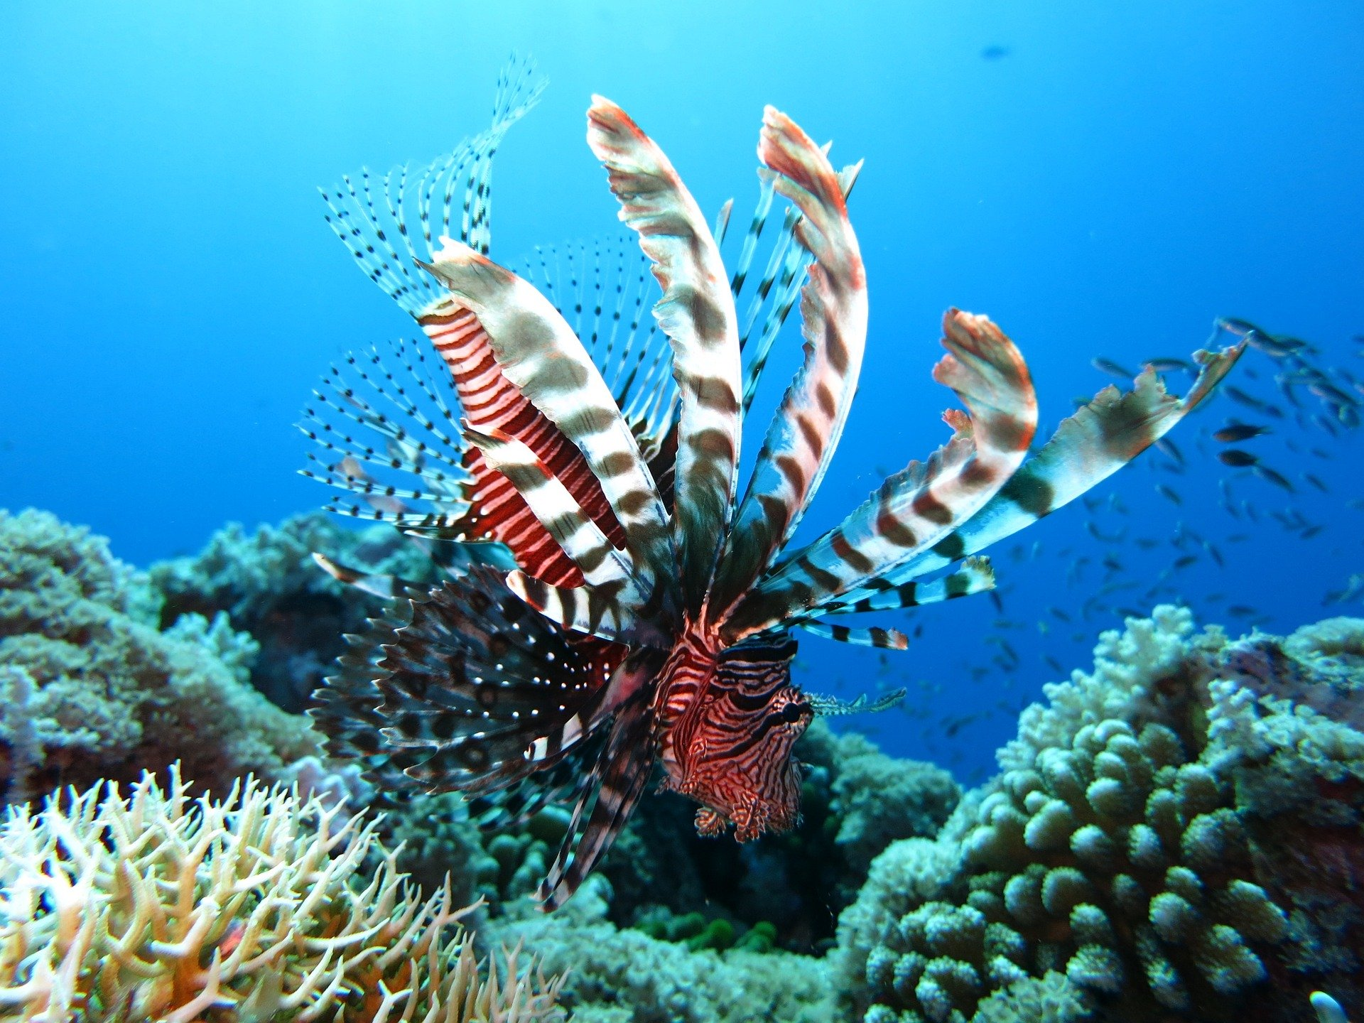
Climate Change & extinctions
Unfortunately, humans are driving lots of species to extinction and disrupting important natural ecosystems – more than 32,000 species are threatened with extinction!
Humans have caused huge destruction across the globe; we have already significantly altered three-quarters of all land and two-thirds of our oceans – meaning we are losing species before we even know anything about them.
Climate change has meant that new, emerging invasive species (= species not normally found in an environment, yet have the ability to spread rapidly) may take advantage of the changing conditions and move into different habitats, disrupting the species that already live there.
The extinction of key species and the arrival of invasive species can change an ecosystem forever.
Lionfish:
A formidable invasive species in the Caribbean and Atlantic Oceans, which is outcompeting native fish for resources.
Take a look at iucnredlist.org to find out more about our endangered species!

Slide 11
Climate Change & extinctions
This is where eDNA comes in…
It is now more important than ever that we understand which species are present in different places and the roles they play in their ecosystems.
The more we know about the ecosystems around us, the better equipped we can be for protecting them.
With the help of eDNA, rare, endangered and new species are being revealed, helping us to ensure these species are protected and conserved.
eDNA can also be used as an early warning for invasive species, helping scientists to respond quickly and appropriately to the threat.

Slide 12
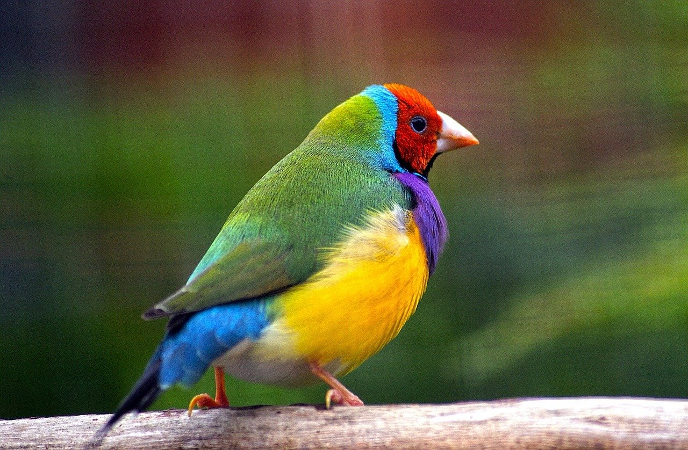
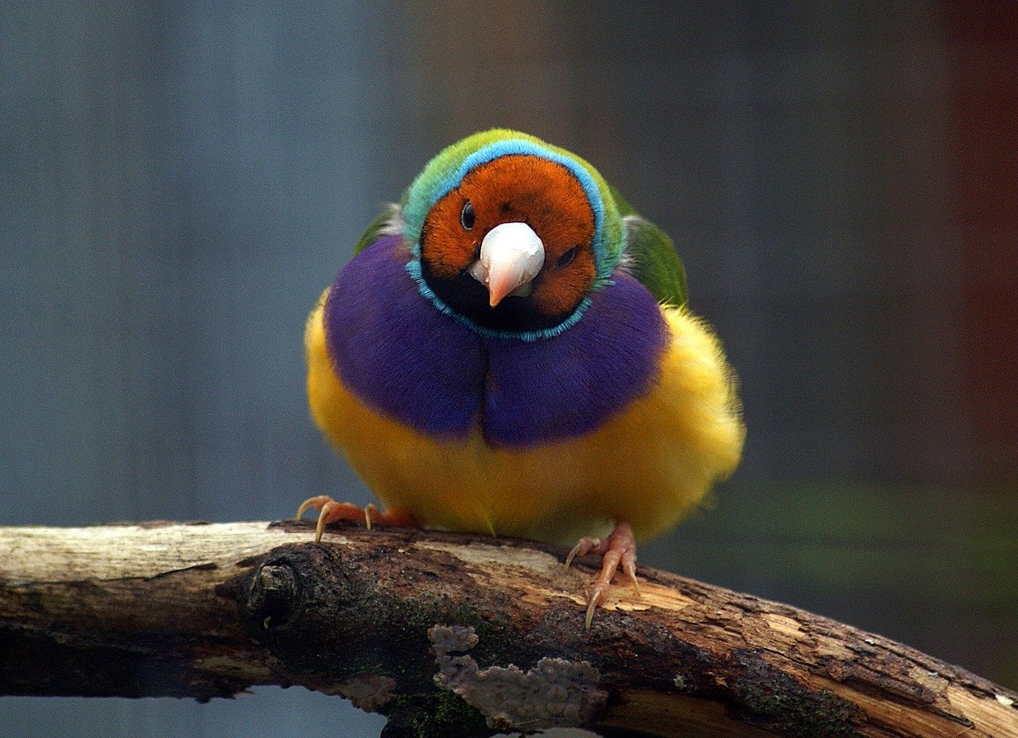
eDNA in action
A group of scientists in Australia were looking for an endangered species of bird called the Gouldian finch…
They decided to use eDNA testing of waterholes that they suspected the Gouldian finch would be drinking from.
Using these samples of water, they were able to identify that this endangered species had visited the waterhole.
Because of eDNA degradation, they were even able to tell that a bird had visited the waterhole within the previous 48 hours.
Using eDNA information like this, we can better understand the species’ behaviours and predict its location.
The Gouldian finch is only found in Australia; this means that it is essential that we protect and conserve it.

Slide 13
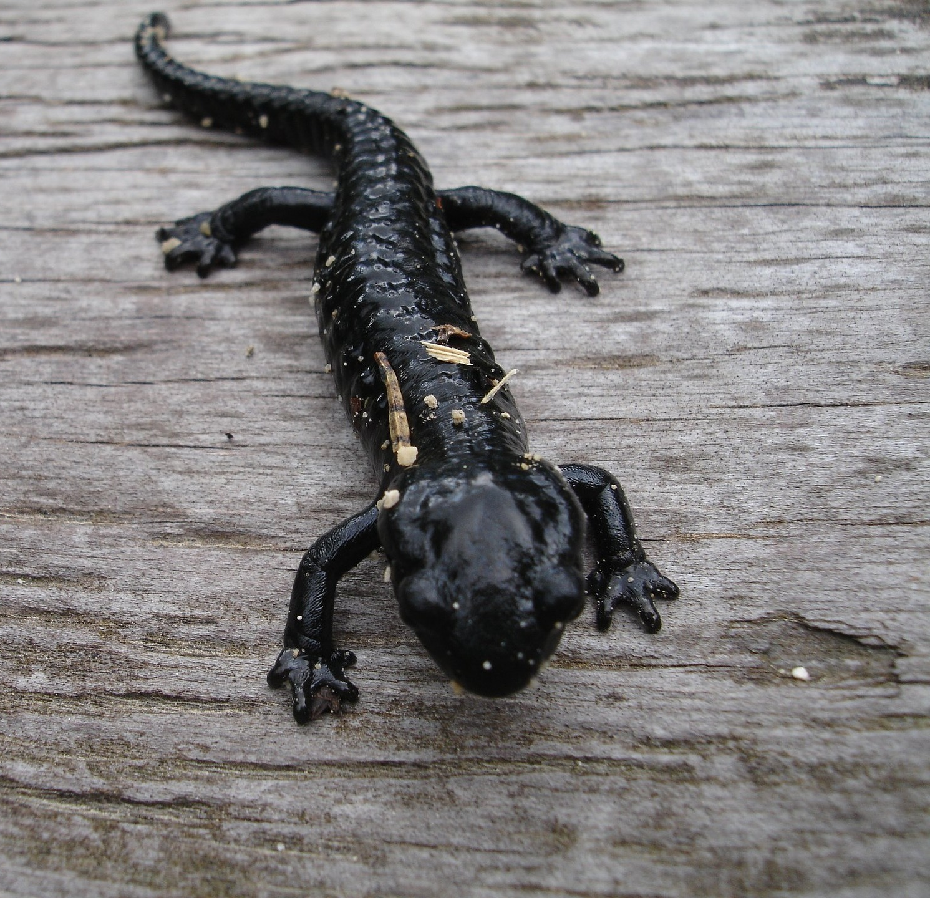
eDNA in aCTION
eDNA technology has been implemented by the UK government…
Great crested newts are an endangered and protected species in the UK.
However, they can be tricky to monitor as many of the traditional methods are harmful, invasive and inaccurate.
They breed in ponds during the spring and hibernate underground in the winter.
To make sure that people do not build houses or car parks near a breeding site, they must prove that these newts do not live there.
In 2014, the UK government approved the use of eDNA analysis as an alternative method of surveying.
This means that we are now much better at detecting and protecting our little newts.
Oi! Human! Don’t build here!

Slide 14
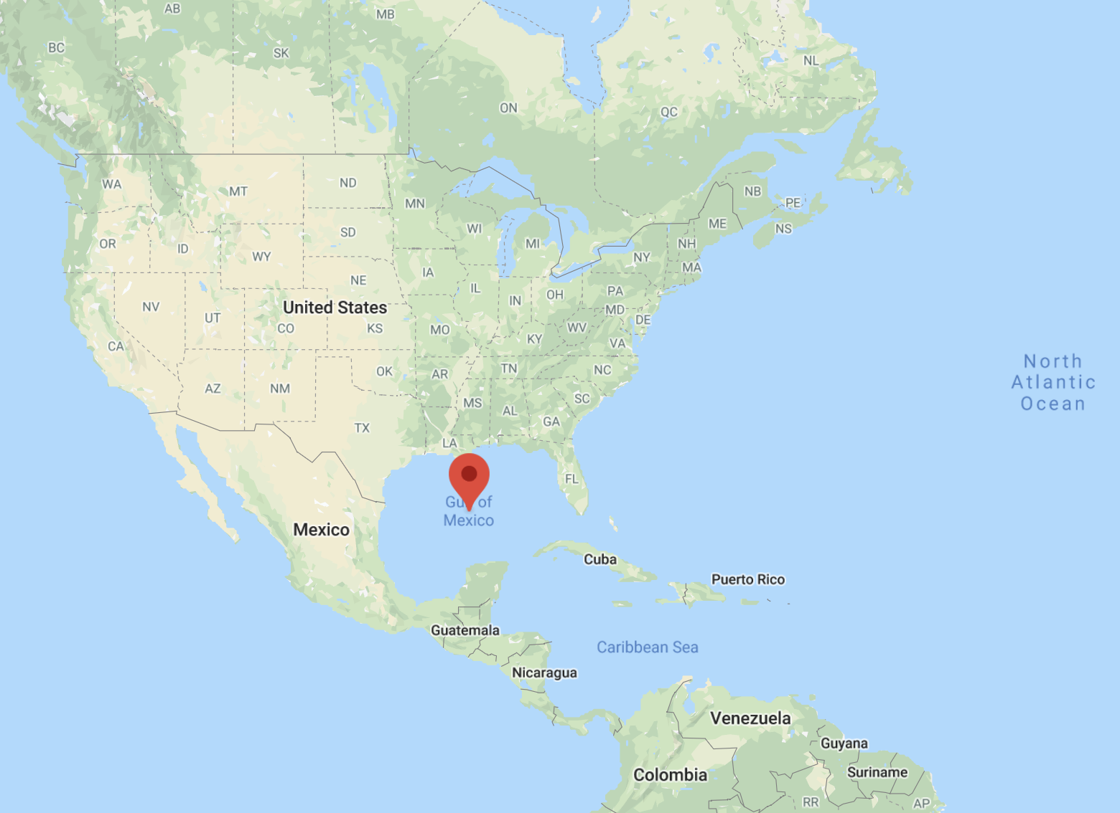
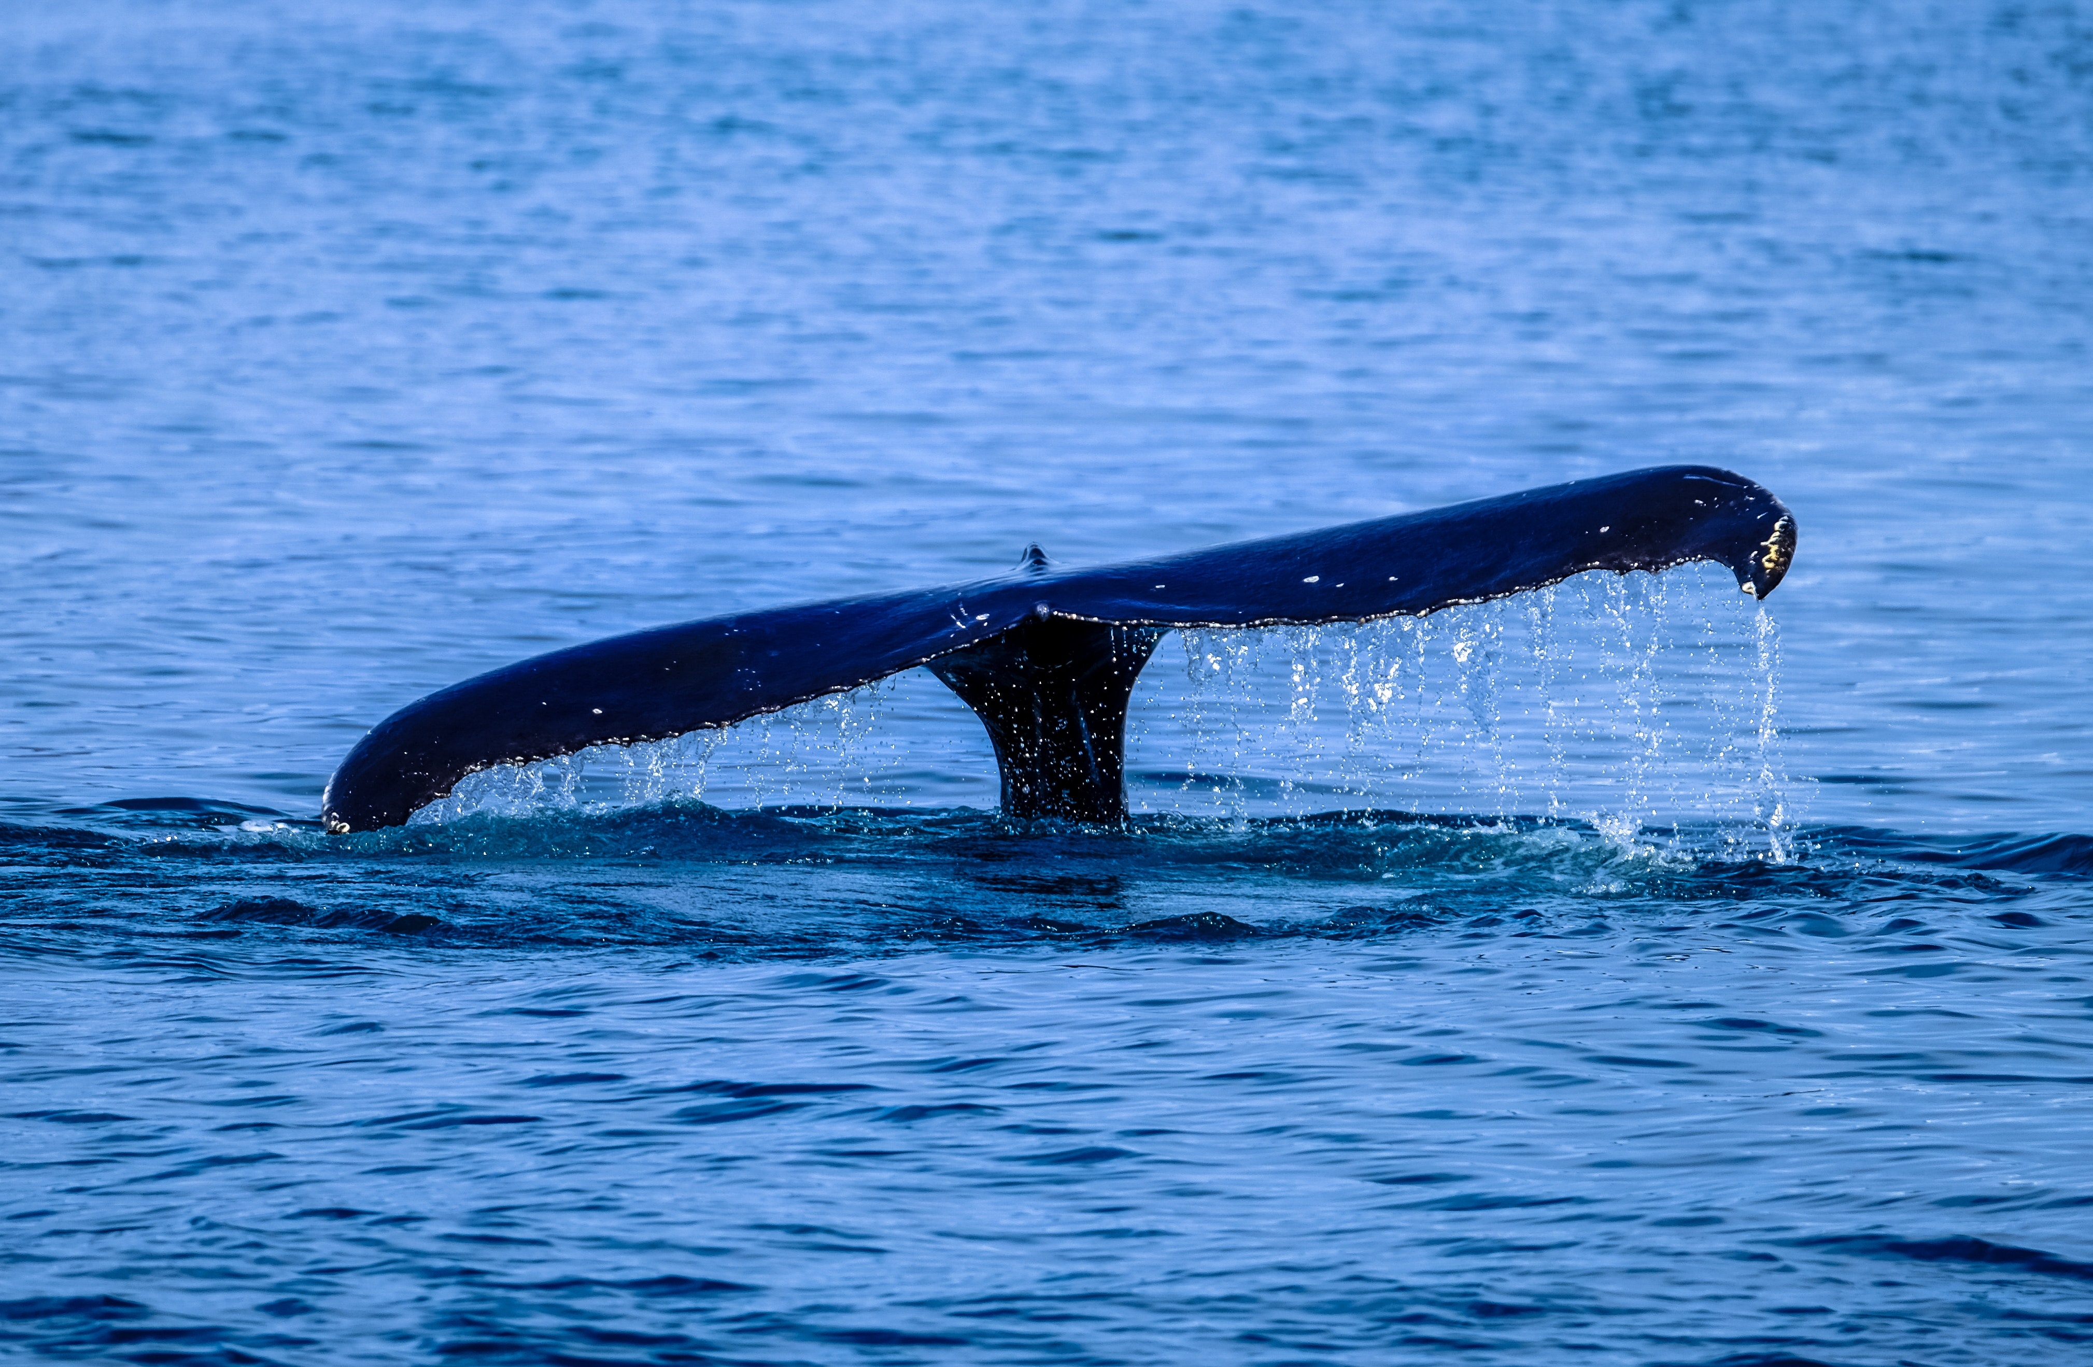
eDNA in action
Saving the most endangered whale species in the world…
Bryde's (pronounced ‘broo-dess’) whales are relatives of Blue and Humpback whales.
The small subspecies found around the Gulf of Mexico are the most endangered in the world with fewer than 100 individuals.
This subspecies is under threat due to oil and gas development, entanglement in fishing equipment, and increasing ocean noise.
They are extremely hard to spot and this has made it difficult for scientists to monitor their numbers… That’s where eDNA comes in!
Scientists have come up with a device that is moored far from the coast and at a depth of 240 meters.
This device collects water samples and preserves the eDNA collected.
Once the device has been recovered, scientists will analyse the eDNA and look for Bryde’s whale DNA.
This will enable us to accurately monitor the numbers of Bryde’s whales around the Gulf of Mexico and ensure they are protected.
Notes:
.

Slide 15
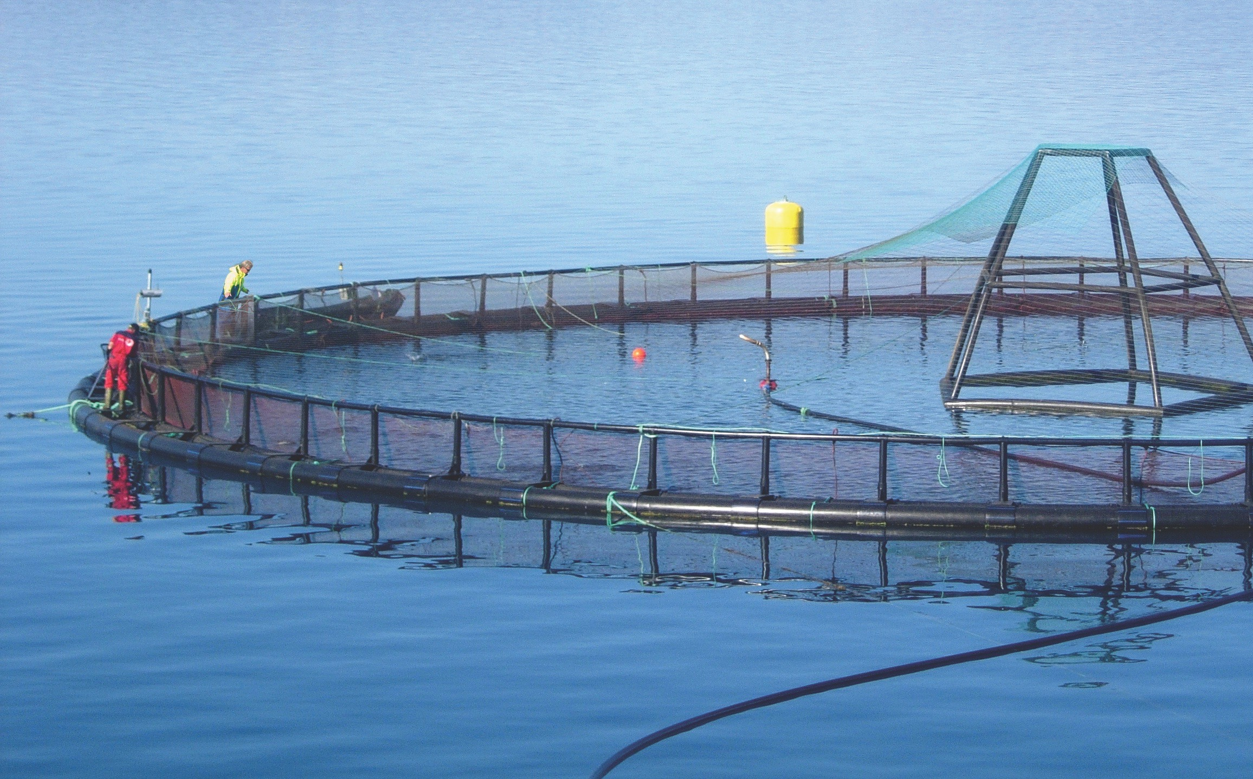
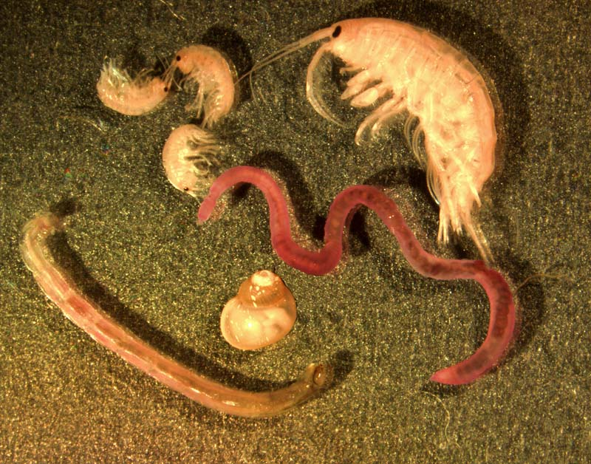
Benthic eDNA applications for aquaculture
Salmon farms are required to demonstrate that they meet environmental standards underneath and around their fish-cages as part of their SEPA licence conditions.
This is achieved by taking samples from the seabed using a boat and grab sampler, identifying the animals that are found using a microscope, and drawing conclusions on the status of the seabed based on the ‘faunal assemblage structure’.
This approach is expensive, time-consuming, and requires considerable taxonomic expertise.
A SAIC-funded project is currently underway to develop DNA-based metagenomics methodologies for seabed monitoring and aquaculture management.
The team will extract DNA from the sediment at the bottom of the sea or loch and will use a DNA sequencer to identify the organisms present. This will save time and money for the fish farmer and also for SEPA, the regulator.

Slide 16
Thank you for listening!
Summary of what we have learned…
DNA provides the blueprint to all our cells.
DNA is made up two single strands, bound together into a helix by hydrogen bonding between complimentary bases.
Certain sections of DNA are unique to that species (‘barcodes’).
Environmental DNA (eDNA) are sections of DNA that have been shed by an organism into their environment.
eDNA is used as a method of monitoring and conserving ecosystems: it is more accurate, faster, cheaper and non-invasive compared to the traditional methods used.
In the current climate crisis, eDNA is a valuable tool in helping to protect our ecosystems!
Visit sUSTAINABLEaquaculture.com to discover more

