Slide 1
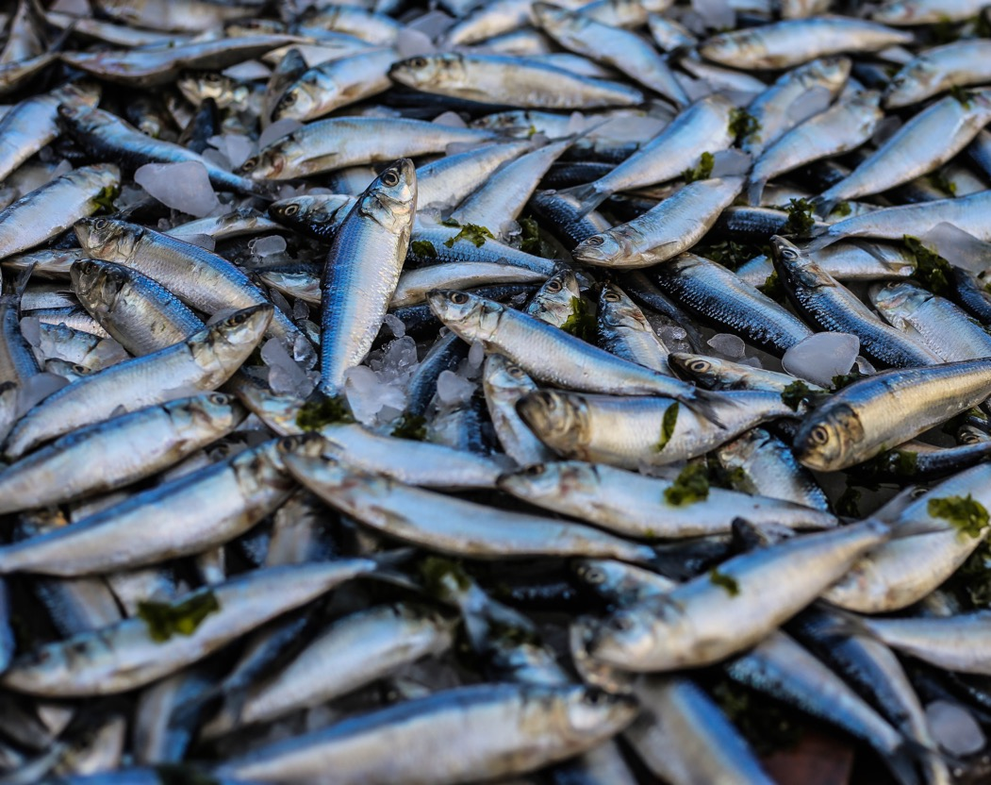
Aquaculture Lesson
Climate Change in Scotland

Slide 2
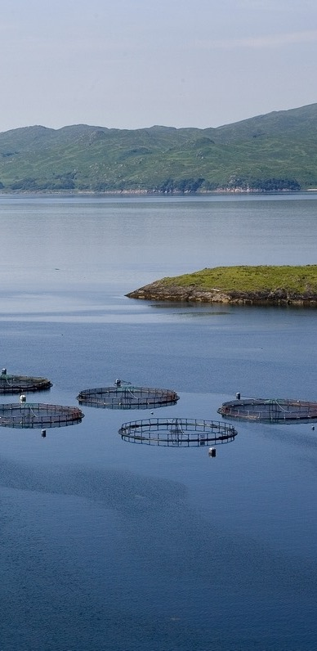
Aquaculture
What is Aquaculture?
“Aquaculture is the farming of aquatic organisms in both coastal and inland areas involving interventions in the rearing process to enhance production.” (FAO)
Finfish and shellfish farming are the most common types of aquaculture.
It is the fastest growing food-producing sector globally and now accounts for 50% of the world’s seafood (FAO).
Aquaculture is essential for the nutrition and employment of millions of people (many who are struggling to maintain reasonable livelihoods).
It can take place in a marine environment or a fluvial environment, depending on the type/size/age of species.
Aquaculture aims to be environmentally sensitive.
https://vimeo.com/384832297

Slide 3
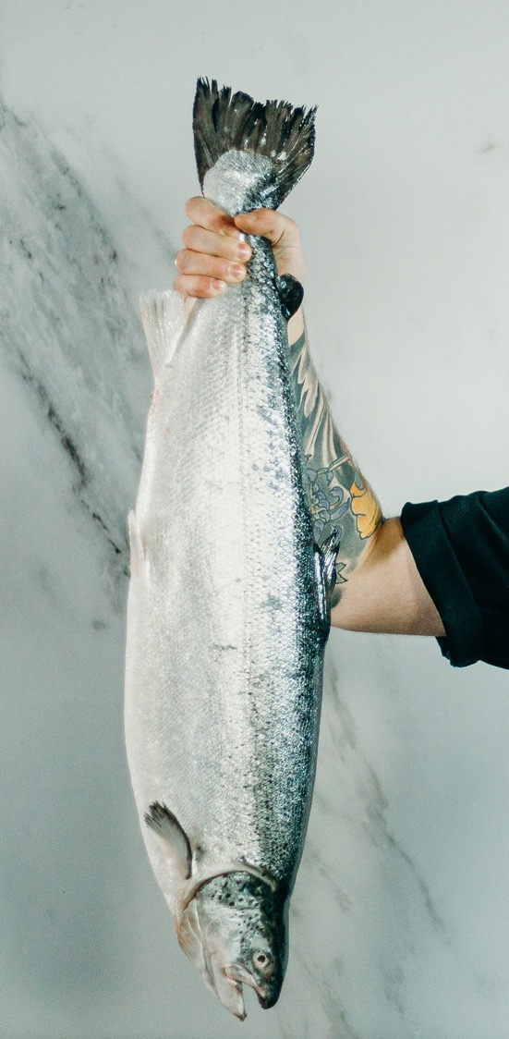
Aquaculture Importance
Why is Aquaculture important?
Aquaculture is a sustainable way forward to help tackle many issues such as: overfishing, food insecurity, poverty, hunger and climate change.
As the population is expect to grow to 9 billion, alternative sustainable food production sectors are needed to feed the growing population.
Aquaculture is also one of the world's most efficient and sustainable methods to produce high-quality protein.
In comparison with terrestrial livestock farming, the industry has low carbon footprint and feed conversion ratio (FCR). It also has high protein and energy retention (Skretting).
70% more food is required by 2050. In order to increase food production globally without overfishing our seas, aquaculture is needed.
https://vimeo.com/340674505

Slide 4
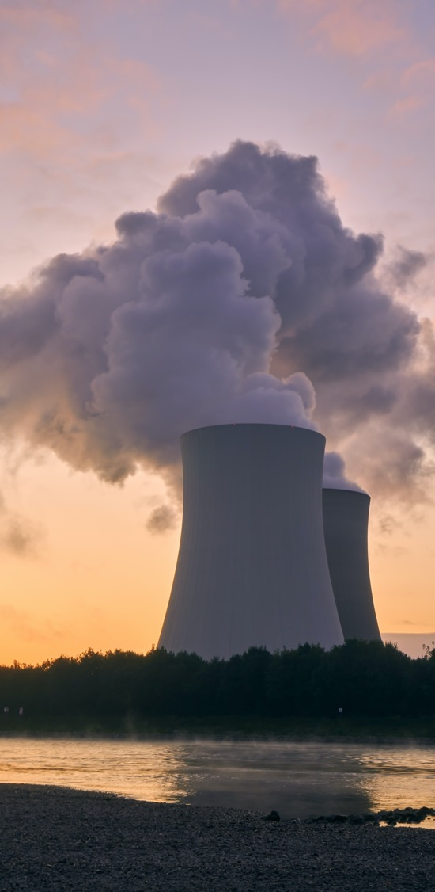
Climate Change
The Anthropocene – What is it?
Earth is currently in the ‘anthropocene’ – a time period when human activity has been the dominant influence on climate and the environment.
In the past 60 years, human impacts have become more visible at an abnormal rate and scale. This period is sometimes known as the Great Acceleration.
Some people suggest the Anthropocene began at the start of Britain's Industrial Revolution in the eighteenth century. Others argue that the Anthropocene began far earlier, when humans began farming.
Regardless of timing, carbon dioxide emissions, global warming, ocean acidification, habitat destruction, extinction and widescale natural resource extraction are all signs that we have significantly modified our planet in recent years (Natural History Museum).
https://vimeo.com/39048998

Slide 5
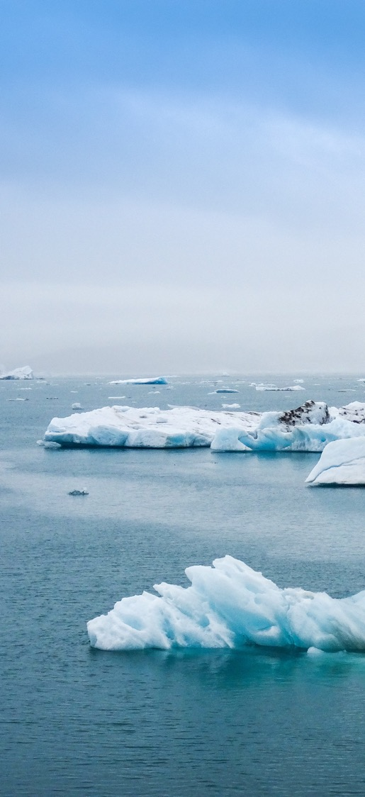
Climate Change
Climate Change Threat
Climatic changes can impact everything on earth and bring large challenges to food production.
Climate change threatens our ability to ensure global food security, end poverty and achieve sustainable development (FAO).
Food security is when people have access to safe and nutritious foods, at all times, in order to maintain an active and healthy lifestyle.
Climate change has both direct and indirect effects on agricultural productivity by changing rainfall patterns, causing drought, flooding, pests and diseases. Therefore, agriculture cannot be the only solution to tackle climate change and food insecurity.
Aquaculture is a sustainable alternative to agriculture but the vast amounts of CO₂ absorbed by the oceans has cause acidification, influencing the health of our oceans and those whose livelihoods and nutrition depend on them.

Slide 6
Challenges facing Aquaculture
Future Challenges Caused by Climate Change
Increase in ocean temperatures
Ocean Acidification
Increase in coastal storms
Increase in pathogens
Harmful planktonic events
Reduced areas of suitable sites
These challenges have the potential to limit the growth and development of this industry.
And more…

Slide 7
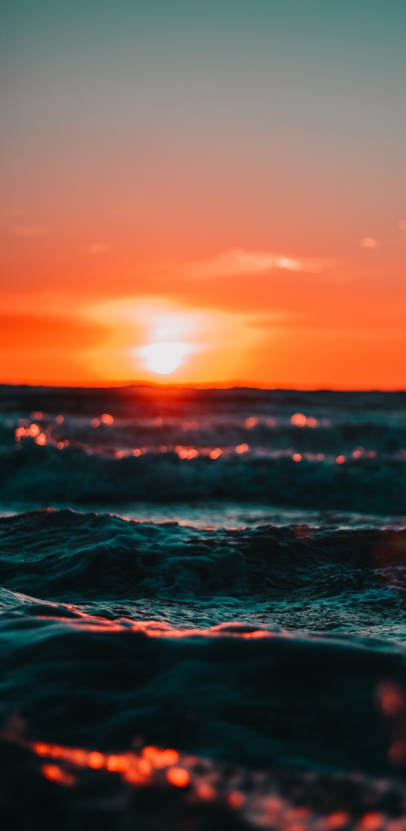
Climate Change and Aquaculture
Increase in Ocean Temperatures
Temperature changes, which affect aquaculture, can occur in both water and air.
Many species in aquaculture are threatened by climate change, with ocean water temperature expecting to rise greater their preferences and zones of optimal growth.
Around the coast of Scotland, and the whole of the United Kingdom, the sea surface temperature is increasing (0.2°C - 0.5°C per decade). (Gov.Scot)
In the west of Scotland, the distribution of marine fish species is changing due to ocean warming. Most species are relocating away from fast warming areas towards slower warming areas (Climefish).
Warming is also affecting the growth and body size of commercial fish species. Fish are experiencing a faster initial growth, but after the age of 1, their growth slows down leading to a smaller adult size (Climefish).

Slide 8
Climate Change and Aquaculture
Increase in Ocean Temperatures
Smaller adult body sizes have direct implications for harvest yield and reproductive potential, leading to an overall decrease in production (Climefish).
Evidence suggests that many species will collapse due to ocean temperature increase (Climefish). A simulation test in the west of Scotland suggest that ecosystem structure will be altered greatly due to climate change and this will likely lead to the collapse of cod (Climefish).
Warmer waters may also enhance the invasiveness of non-native species.
However, not all species will be affected negatively. For example, warmer water conditions could potentially allow new species to be cultured in Scotland and bring benefits (e.g. larger growth rates) to species who can tolerate warmer water (Fisheries Research Services).
However, species that are threated by climate change must be protected to prevent any further reduction in ocean species and food production.

Slide 9
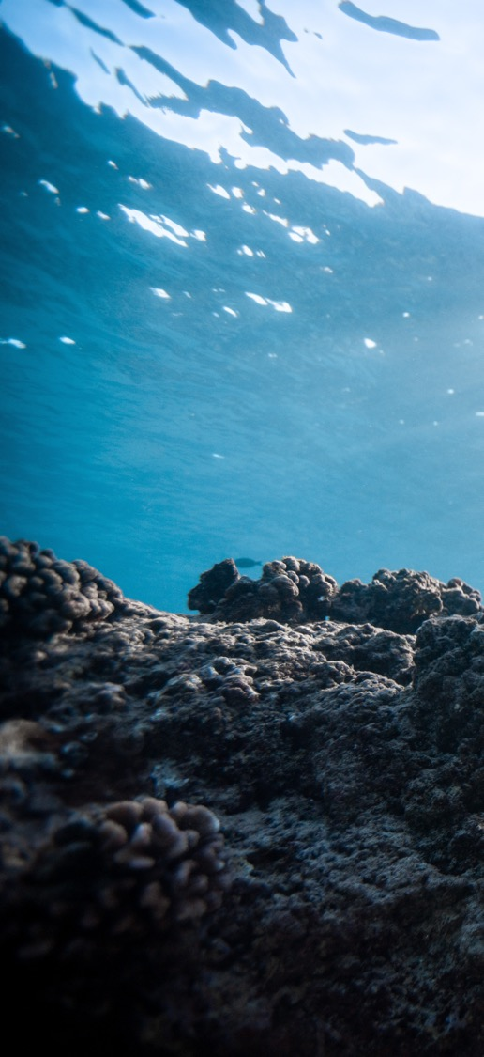
Climate Change and Aquaculture
Ocean Acidification
The world’s oceans have had a slightly alkaline state (average pH of 8.2) for the past few million years. With carbon emissions escalating, there is now more CO₂ in the world’s atmosphere, altering the pH of oceans (The Conversation).
The oceans are a net absorber of carbon dioxide (CO₂). However, absorbing this leads to acidification and reduce ability to absorb further CO₂ (NOAA).
When CO₂ is absorbed by seawater, chemical reactions occur that reduce seawater pH, carbonate ion concentration, and saturation states of biologically important calcium carbonate minerals. Many species rely on these to exist (NOAA).
Since the beginning of the industrial revolution, oceanic uptake of CO₂ has resulted in increasing acidification of the ocean (26% increase in acidity globally). This has caused devastating impacts on many marine species (NOAA).
Therefore, ocean acidification is a threat to food security, economies, and culture because of its potential impacts on marine ecosystem services.

Slide 10
Climate Change and Aquaculture
Ocean Acidification
By the end of the century it is predicted that levels of acidity in the oceans will have a pH value of around 7.8 on average, and this will bring with it some serious effects for the aquaculture industry (The Fish Site).
Acidic water is a major problem for shellfish.
When CO2 is absorbed by the sea water, it produces an acid that has a corrosive effect (degradation of surface) on calcium. Shellfish need calcium to develop shells and to produce healthy bone growth (The Fish Site).
Acidification makes it difficult for shellfish to grow a tough outer shell, which is essential for their health and survival. As a result, shellfish produce thin shells and do not develop properly (The Fish Site).
This weakens their immune systems, making them more vulnerable to disease.
https://youtu.be/x7MpI9dZIjk

Slide 11
Climate Change and Aquaculture
Ocean Acidification
In the UK, the future impacts of acidification on commercial fish stocks are still uncertain. However, recent research has indicated that annual economic losses, caused by acidification, could reach £7.47 million by 2100 (GOV.UK).
Scotland is famous for its high-quality shellfish and it is one of Scotland’s most valuable food export. Acidification of Scottish waters, caused by climate change, would result in major losses economically.
Although impacts are less clear in the UK, coastal acidification will be made worse by climate change, causing an increase in freshwater run-off (more rainfall) and sea-level rise (University of Stirling).
Significant amounts of carbon are captured and stored within the Scottish marine environment; therefore, it is essential in protecting them to avoid any human impacts reducing their carbon storage capacity (FishFocus).

Slide 12
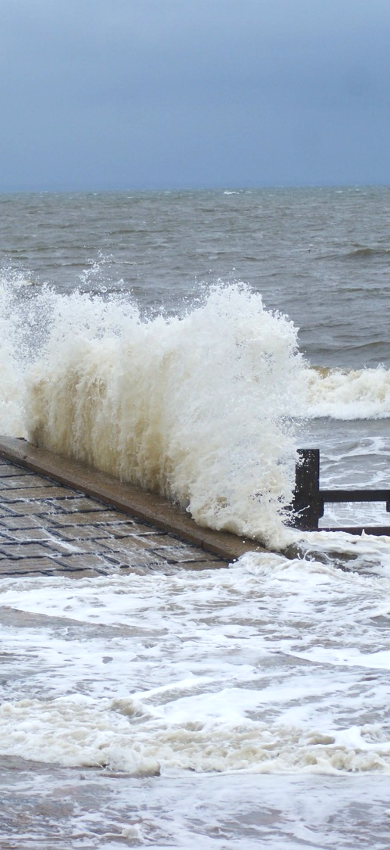
Climate Change and Aquaculture
Increase in Coastal Storms
Climate change has resulted in extreme weather conditions becoming more intense and more frequent.
Every year, Scotland experiences extreme sea levels rises, caused through storm surges, high tides and wave action. Climate change is likely to increase the frequency and intensity of these storms.
Storms are a major threat to aquaculture as it can cause material damage or flooding of freshwater farms, resulting in escapees and loss of fish.
Escapees are not only an economic loss but cause a threat to wild fish populations.
Escaped fish may cause undesirable genetic effects in native populations through interbreeding, and ecological effects through predation, competition and the transfer of diseases to wild fish (Europa).

Slide 13
Climate Change and Aquaculture
Increase in Coastal Storms: Mowi Example
Mowi is a aquaculture company, having many farms around Scotland. Some sites are located in an areas prone to coastal storms, with some pens being situated in particularly exposed locations.
Despite the net pens designs meeting technical standards and having modern infrastructure to withstand storms, damage still occurred, showing the intensity of current storms hitting Scotland.
In January, 2020, storm Brendan caused great damage to one net pen at Mowi’s salmon farm in Colonsay, resulting in a loss of 73 600 salmon.
In August, 2020, Storm Ellen hit the UK and Ireland, causing Mowi’s salmon farm at Carradale North to loose 550,000 salmon. This was caused after the pen shifted position after its seabed anchors became dislodged during the storm.
Storms cause great devastation to aquaculture sites and is an issue that must be considered more as climate change becomes more visible.

Slide 14
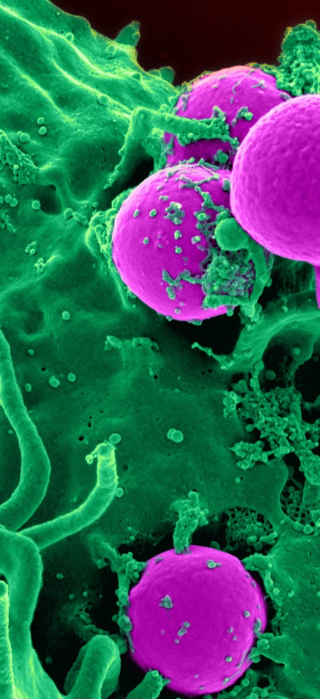
Climate Change and Aquaculture
Increase In Pathogens
A rise in ocean temperature has been found to influence the severity and duration of aquaculture disease outbreaks (TheFishSite).
When fish are under conditions of thermal stress, they are likely to be more susceptible to disease and fatalities (UNEP‐WCMC).
It has been predicted that with increasing temperatures, it is possible that temperate regions could see shorter and more severe outbreaks (TheFishSite).
With warming winters, pathogens and parasites that normally go dormant in colder winter conditions could potentially increase their parasite survival and reproductive output (TheFishSite).
The geographic range of certain parasites are also expanding. Warmer conditions may also allow the establishment of exotic diseases (UNEP‐WCMC).

Slide 15
Climate Change and Aquaculture
Increase In Pathogens
Scottish Aquaculture is likely to experience more bacterial, viral, parasitic and fungal diseases as the climate and oceans gets warmer.
However, as most fish are poikilothermic (body temperature changes with the temperature around them), it is expected that warmer water will mean their immune system will function more effectively (Fisheries Research Services).
This will prevent the establishment of infections up to their thermal optimum (not too warm, not too cold).
However, once ocean temperatures reach above their thermal optimum they will be under more thermal stress and more susceptible to disease (Fisheries Research Services).
Warmer water also hold less oxygen than cold water, which could result in oxygen depletion, causing disease and welfare issues (Fisheries Research Services).

Slide 16
Climate Change and Aquaculture
Increase In Pathogens
With the survival of winter dormant diseases and the introduction of new exotic diseases, Scottish aquaculture faces a great challenge.
It is difficult to understand/predict the response and progression of diseases in the UK. New diseases could develop whilst diseases that prefer cooler climatic conditions could decline (Fisheries Research Services).
Nevertheless, when optimum temperatures are reached, disease will be a major problem.
Disease will not only effect the welfare of fish but it has the potential to cause a threat to human health.
Human consumption and exposure to marine diseases has been estimated to have resulted in millions of dollars in health costs. Marine diseases can adversely affect human health through consumption of contaminated seafood, ingestion of water‐borne pathogens (UNEP-WCMC).

Slide 17
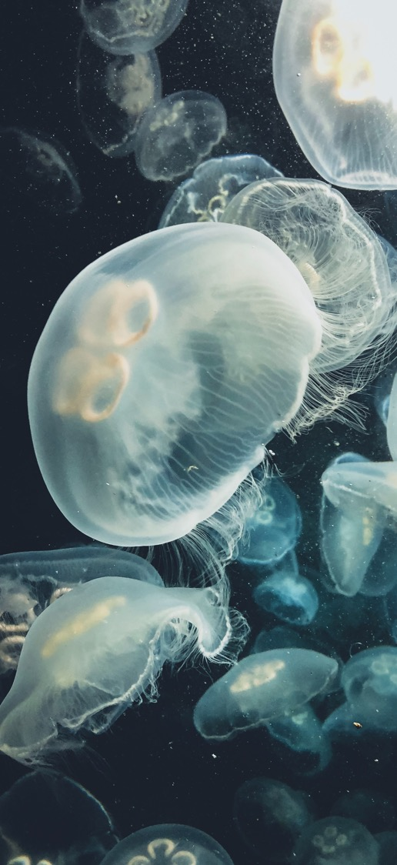
Climate Change and Aquaculture
Harmful Planktonic Events
Climate change is having a complex effect on planktonic communities.
Several studies have associated rising surface temperatures with an increase in phytoplankton (MCCIP).
Phytoplankton groups contain potentially toxic or nuisance species that can stress or kill cultured finfish or result in harvesting closures for shellfish growing waters.
Reduced summer rainfall, caused by global warming, could result in an increase the toxicity of some phytoplankton species (MCCIP).
It is possible that the future hydrodynamic regime of Scotland will result in new toxic / nuisance species may pose problems for aquaculture.

Slide 18
Climate Change and Aquaculture
Harmful Planktonic Events
Jellyfish have also been shown to increase in abundance in association with climate change (as well as overfishing) (MCCIP).
Jellyfish are expanding towards sites where finfish are predominantly cultivated.
Jellyfish can cause pathology (disease and/or injury) in the gills of salmon and kill entire stocks.
However, jellyfish are poorly monitored and it is difficult to determine whether climate change is affecting their abundance and distribution.
Nevertheless, there has been an abundance of warmer water species found at higher latitudes in recent years (MCCIP).

Slide 19
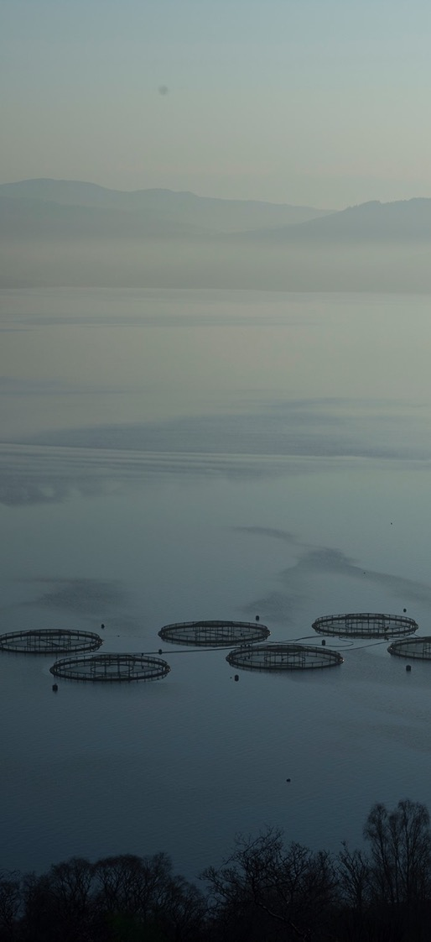
Climate Change and Aquaculture
Site Availability
The areas where aquaculture currently operates may have to change in the future due to climate change.
Rises in sea levels are likely to result in loss of shallow coastal habitat, important for aquaculture. This is because soft sediments (needed for oysters) and shallow areas (needed for mussels) will be lost (MCCIP).
Coastal storms also pose a great threat and may require aquaculture locations to move towards sheltered locations. This will unlikely happen as the expansion of aquaculture will mean moving to more exposed offshore locations.
Species being currently farmed may require moving to less acidic areas, in order to produce optimum growth and prevent disease.

Slide 20
Fighting Climate Change
How Can Geographers Help?
Work in aquatic pathobiology (study the prevention, diagnosis and treatment of aquatic animal diseases in cultured organisms.).
Monitor and study ocean acidification and the impact this is having on cultivated species.
Help create new innovation to tackle climate change (e.g. engineer aquaculture net pens – able to withstand coastal storms).
Work on-site taking local measurements (e.g measuring acidity, salinity, ocean surface temperature and oxygen levels) and maintaining good fish welfare.
Study and help predict the future climate of Scotland.
Study surrounding species and the impact they could have on aquaculture species.

Slide 21
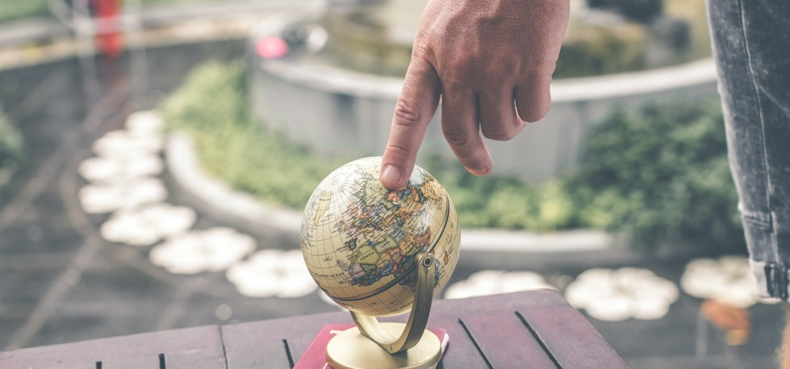
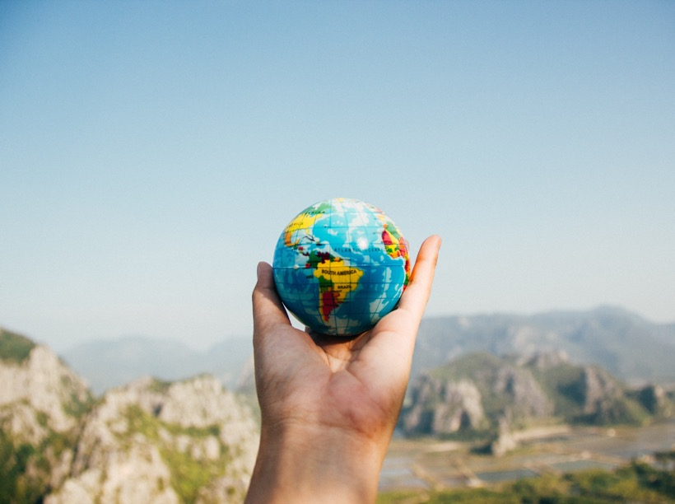
Aquaculture Needs Geographers
Help drive innovation and work on the front line to combat climate change and food insecurity.
Aquaculture offers many career opportunities for geographers.
Contact SAIC for more information on career opportunities.

